Slide 1

Weekly Review
02/03/21
Tasks
Cloth manipulation using random policy ✅ (Last week)
Code Soft Actor Critic from scratch ✅
Understand the existing repository completely ✅ Enough to start implementation
Custom Implementation : Cloth environment with SAC approach⚠️In progress
To-Do Items for Next Week
Finish custom Implementation : Cloth environment integrate to SAC approach
Prepare SAC Pipeline Explanation
To-Do Later
Define reward function and action for new use case
Explore usage of intermediate testing on simulation before sim-to-real transfer
Define use-case (for different type of towels (colour, texture, etc. ) / one type )
Check the no. of episodes needed, Check computational requirements

Slide 2
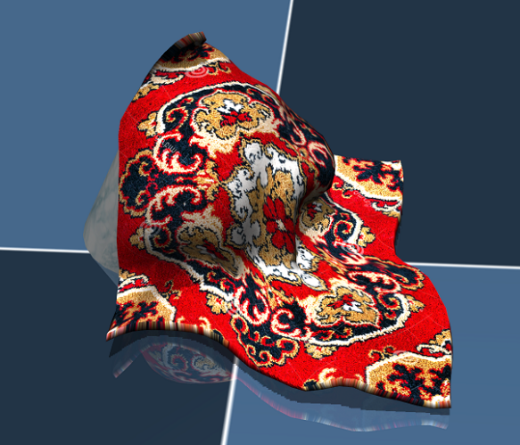
Cloth Manipulation – RL Problem
02/03/21
Agent
Action
State/Observation
, Reward
Environment (Mujoco)

Slide 3
Cloth Manipulation using random policy
02/03/21
Policy (state - action)=
Random action in a specific range
Observation
(64*64 img)
Action
Pick point and place point
From random pixel points
Inside segmented mask
Agent
Reward
(Overlap with goal state)
Environment (Mujoco)

Slide 4
Cloth Simulation using SAC
02/03/21
SACAgent
(Deep Learning for policy)
State -> Actor Network -> Action
State, action -> Critic Network 1 ->
Quality of action
State, action -> Critic Network 2 -> Quality of action
State -> Value Network -> Value
State, action -> Target Value Network -> Value
Agent
Action
Pick point and place point
From random pixel points
Inside segmented mask
Observation
(64*64 img)
Reward
Environment (Mujoco)

Slide 5
Plan
02/03/21
Planned
Phase 3 : Implementation : 52 days (mid Feb- early Apr)
Testing various simulation environments and selecting one : 13 days
Setting up the Reinforcement Learning Platform and Simulation environment : 9 days
Dataset generation on chosen simulation platform : 15 days
Perform Reinforcement Learning using PyTorch : 15 days
Update
Phase 3 : Implementation : 52 days (mid Feb- early Apr)
Setting up the Reinforcement Learning Platform and Simulation environment : 13 days
Prepare a custom implementation taking existing states, actions, rewards : 9 days
Redefine actions and rewards for our use case : 15 days
Test the pipeline and iterate : 15 days

Slide 6
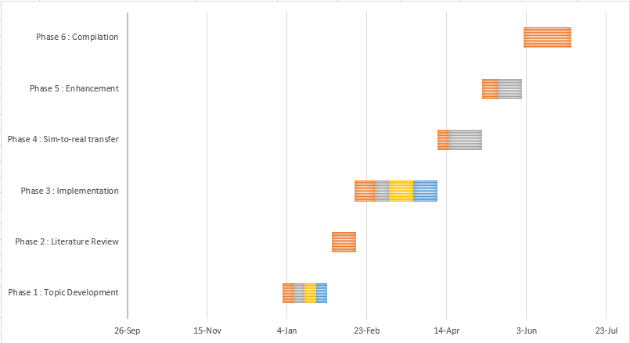
Plan
02/03/21
Phase 3 : Implementation : 52 days (mid Feb- early Apr)
Setting up the Reinforcement Learning Platform and Simulation environment : 13 days
Prepare a custom implementation taking existing states, actions, rewards : 9 days
Redefine actions and rewards for our use case : 15 days
Test the pipeline and iterate : 15 days

Slide 7
Weekly Review
02/03/21
Tasks
Cloth manipulation using random policy ✅ (Last week)
Code Soft Actor Critic from scratch ✅
Understand the existing repository completely ✅ Enough to start implementation
Custom Implementation : Cloth environment with SAC approach⚠️In progress
To-Do Items for Next Week
Finish custom Implementation : Cloth environment integrate to SAC approach
Prepare SAC Pipeline Explanation
To-Do Later
Define reward function and action for new use case
Explore usage of intermediate testing on simulation before sim-to-real transfer
Define use-case (for different type of towels (colour, texture, etc. ) / one type )
Check the no. of episodes needed, Check computational requirements

Slide 8
THANK YOU

